Slide 1
TITANIC DATASET EXPLORATORY DATA ANALYSIS (EDA)
MEINA LISA

Slide 2
DESCRIPTION
Background
Goals
This dataset provides passenger information from the Titanic. The initial exploration focuses on Survived, Name, Sex, and Age to understand how certain factors might have influenced survival chances, as the data contains many interesting details.
Understand the distribution of Titanic Data (age, gender, etc.)
Analyze patterns and relationships between variables.
Find then handle any duplicate entries and missing data.
Discover initial insights useful for further analysis.

Slide 3
WORKFLOW OVERVIEW
1. Data Understanding
2. Data Cleaning
Examine data structure.
Observe data distribution and statistics.
Remove duplicates.
Handle missing values.
3. Exploratory Data Analysis
4. Insight & Interpretation
Visualize distributions.
Analyze variable relationships.
Summarize data.
Identify influential factors.

Slide 4
DATASET OVERVIEW
Titanic dataset contains 500 rows and 4 columns: survived, name, sex, and age.
survived | name | sex | age
1 | Allen, Miss. Elisabeth Walton | female | 29.00
1 | Allison, Master. Hudson Trevor | male | 0.92
0 | Allison, Miss. Helen Loraine | female | 2.00
0 | Allison, Mr. Hudson Joshua Creighton | male | 30.00
0 | Allison, Mrs. Hudson J C (Bessie Waldo Daniels) | female | 25.00

Slide 5
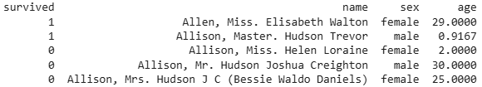
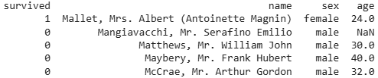
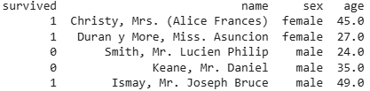
DATA SAMPLE
Showing Top 5 rows
Showing Bottom 5 rows
Showing Random 5 rows

Slide 6
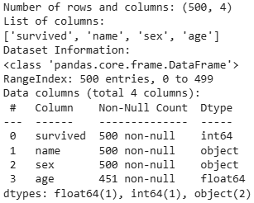
DATASET INFORMATION

Slide 7
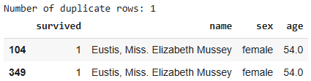
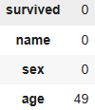
DATA CLEANING
Remove Duplicate
Handle Missing Value
Showing duplicate data:
Method:
duplicates = df.duplicated()
Result:
Handling:
df = df.drop_duplicates ().reset_index(drop=True)
Identifying missing value:
Method:
missing_count = df.isnull().sum()
Result:
Handling:
Missing values in the 'Age' column were filled with the median: 35.0

Slide 8
EXPLORATORY DATA ANALYSIS

Slide 9
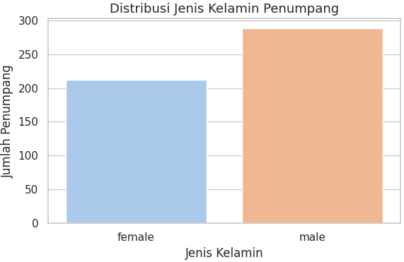
SEX DISTRIBUTION
Analysis:
288 male passengers
211 female passengers
Dominated by male (57.7%)

Slide 10
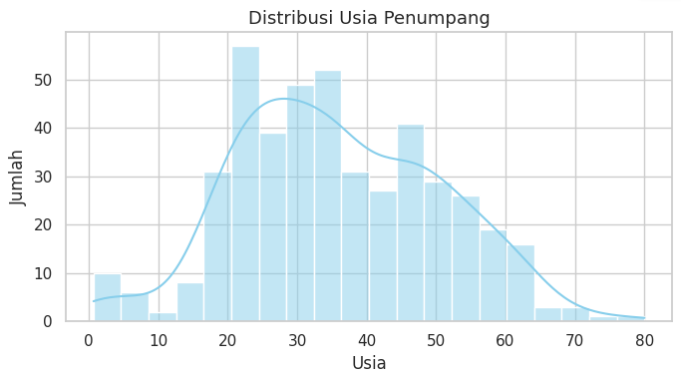
AGE DISTRIBUTION
Analysis:
Dominated by adults (20 – 59 years), with 413 people out of 499 total

Slide 11
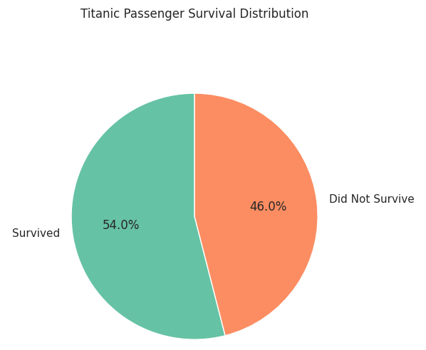
SURVIVAL RATE
Analysis:
The distribution of survivors vs non-survivors is relatively balanced.

Slide 12
CONCLUSIONS
Summary of Findings:
The dataset contains 500 rows and 4 columns: survived, name, sex, and age.
The age column had 49 missing values (9.8%), which were addressed using median imputation.
There was one duplicate data, so 1 row were removed.
Average passenger age: approximately 29 years, ranging from 0.75 to 80 years old.
Passenger composition: 288 males and 212 females.
Survival count: 270 passengers survived, and 230 did not survive.

Slide 13
THANKS!
meinalisa02@gmail.com
+(62) 852 6049 8159

